Slide 1
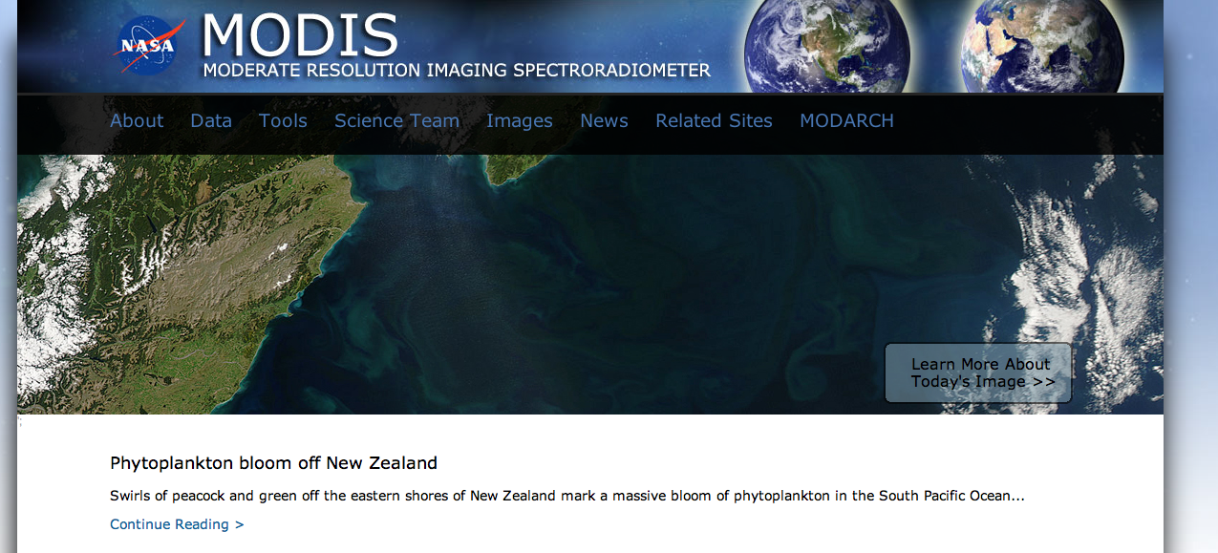
http://modis.gsfc.nasa.gov

Slide 2
DETAILS OF THE INSTRUMENT
MODIS (or Moderate Resolution Imaging Spectroradiometer)
This instrument is on two satellites:
Terra – crosses over the equator in the morning.
Aqua – crosses over the equator in the afternoon.
Viewing the entire Earth's surface every 1 to 2 days.
Orbit: 705 km, 10:30 a.m. descending node (Terra) or 1:30 p.m. ascending node (Aqua), sun-synchronous, near-polar, circular
Swath Dimensions:
- 2330 km (cross track) by 10 km (along track at nadir)
Acquiring data in 36 spectral bands, or groups of wavelengths.

Slide 3
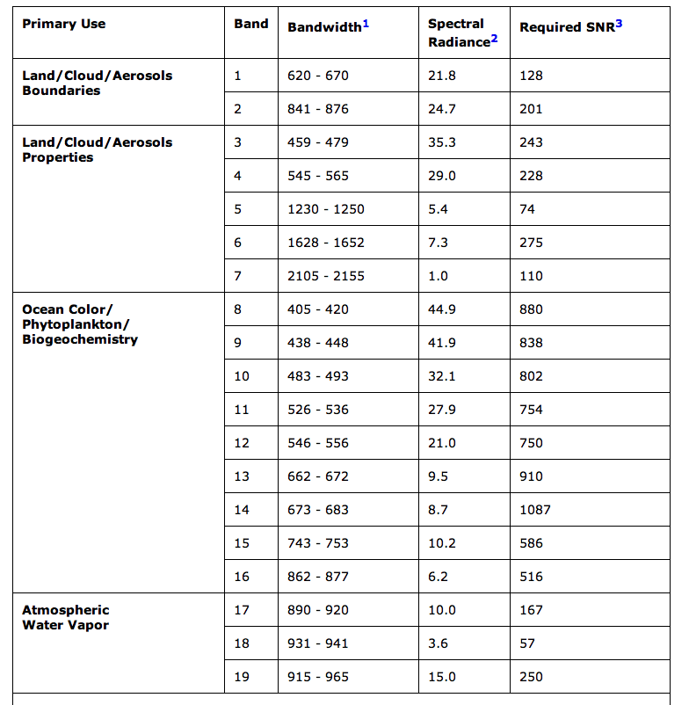

Slide 4
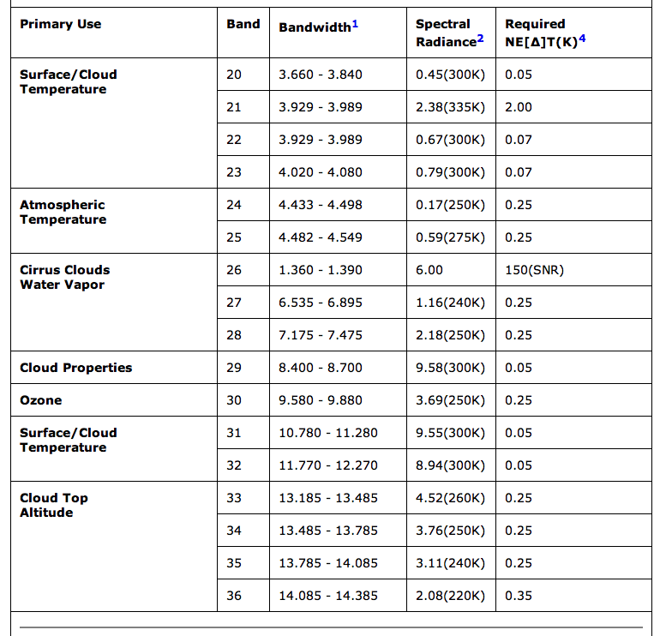

Slide 5
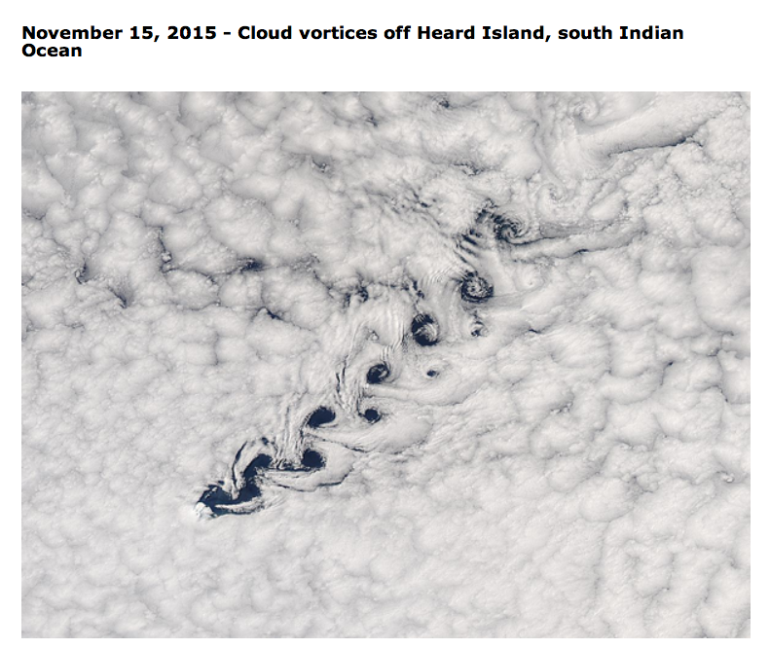
http://modis.gsfc.nasa.gov/gallery/showall.php

Slide 6
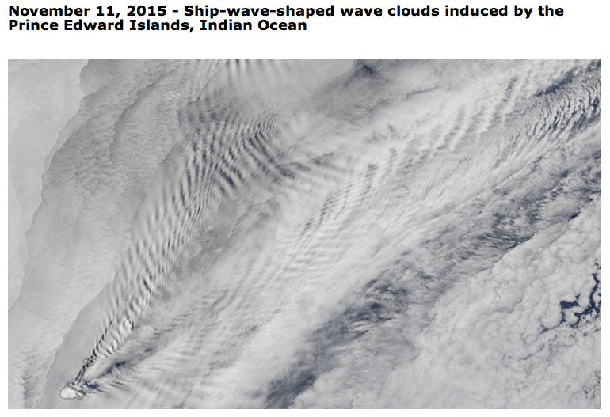

Slide 7
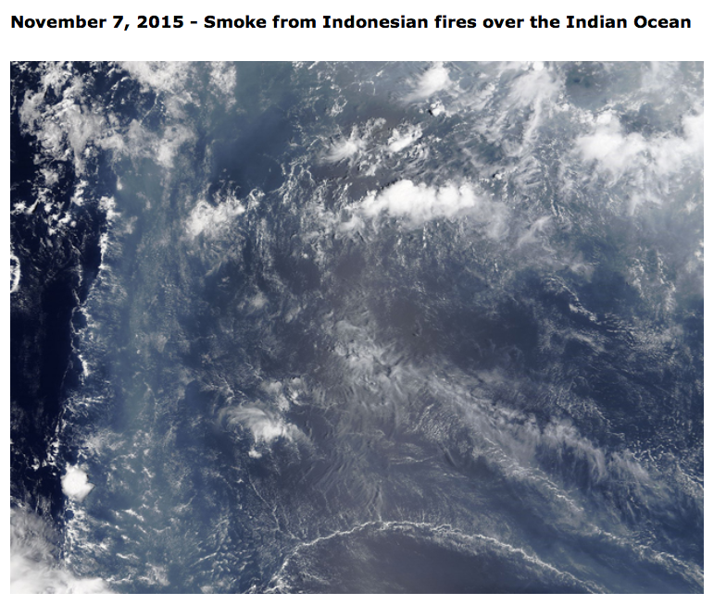

Slide 8
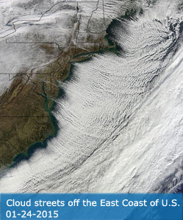
The MODIS Cloud Product combines infrared and visible techniques to determine both physical and radiative cloud properties.
Cloud-particle phase (ice vs. water, clouds vs. snow), effective cloud-particle radius, and cloud optical thickness are derived using the MODIS visible and near-infrared channel radiances.
Cloud-top temperature, height, effective emissivity, phase (ice vs. water, opaque vs. non-opaque), and cloud fraction are produced by the infrared retrieval methods both day and night at 5x5 1-km-pixel resolution.

Slide 9
MODIS cloud products
CTT: cloud top temperature
CTP: cloud top pressure
CF: cloud fraction
- usually given as a 0 or 1: 1 for cloud, 0 for no cloud.
- for regions in which a cloud covers part of a grid, a fraction is used.
Tau: cloud optical thickness
measurement of how much radiation can pass through a cloud
depends on the moisture density and vertical depth (thickness) of a cloud
thick clouds: high optical depth (impossible to see through the cloud)
thin clouds: low optical depth (possible to see through the cloud).

Slide 10
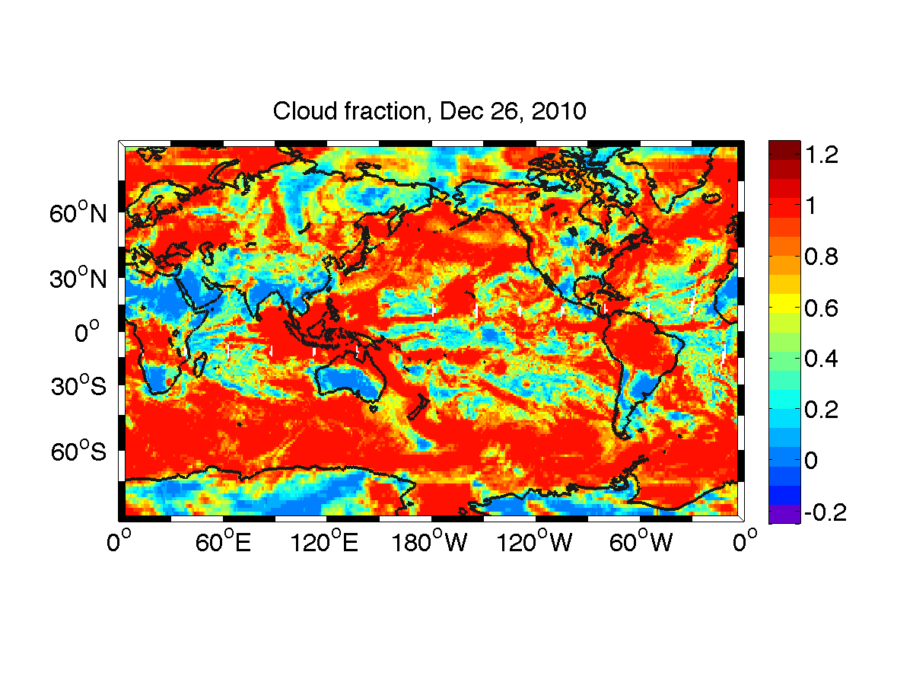
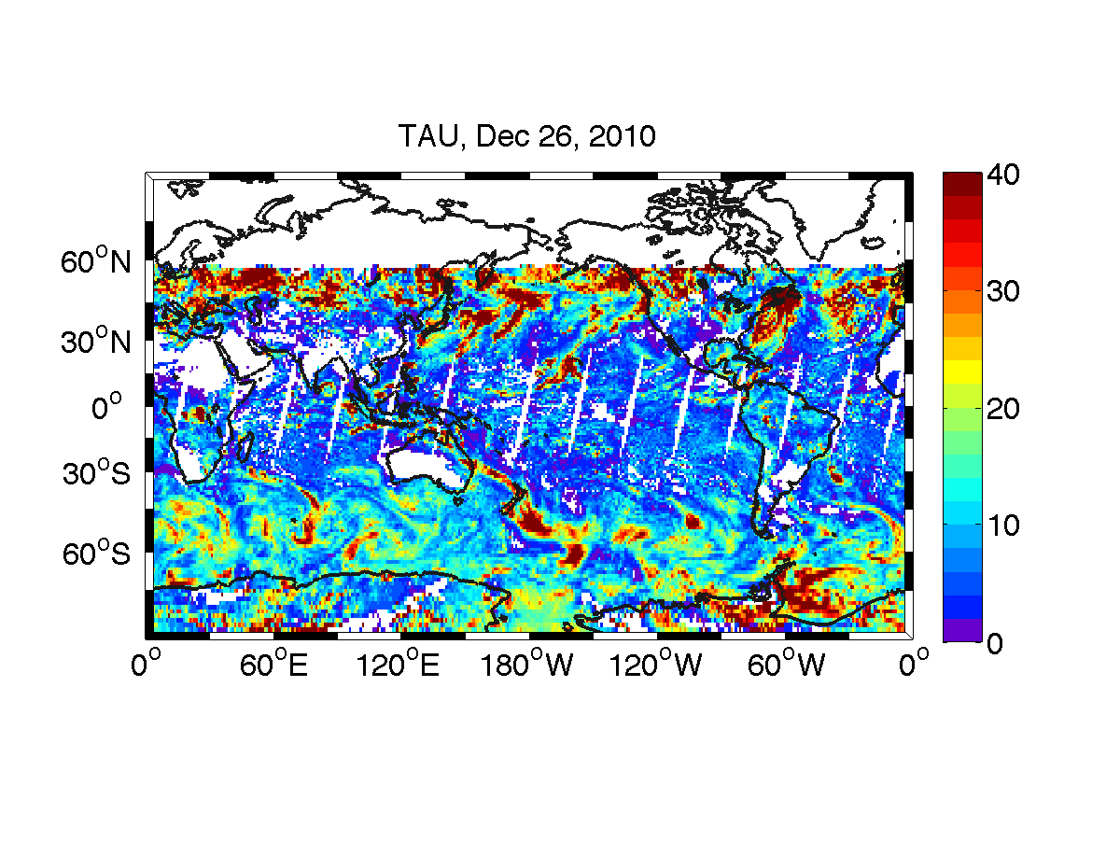
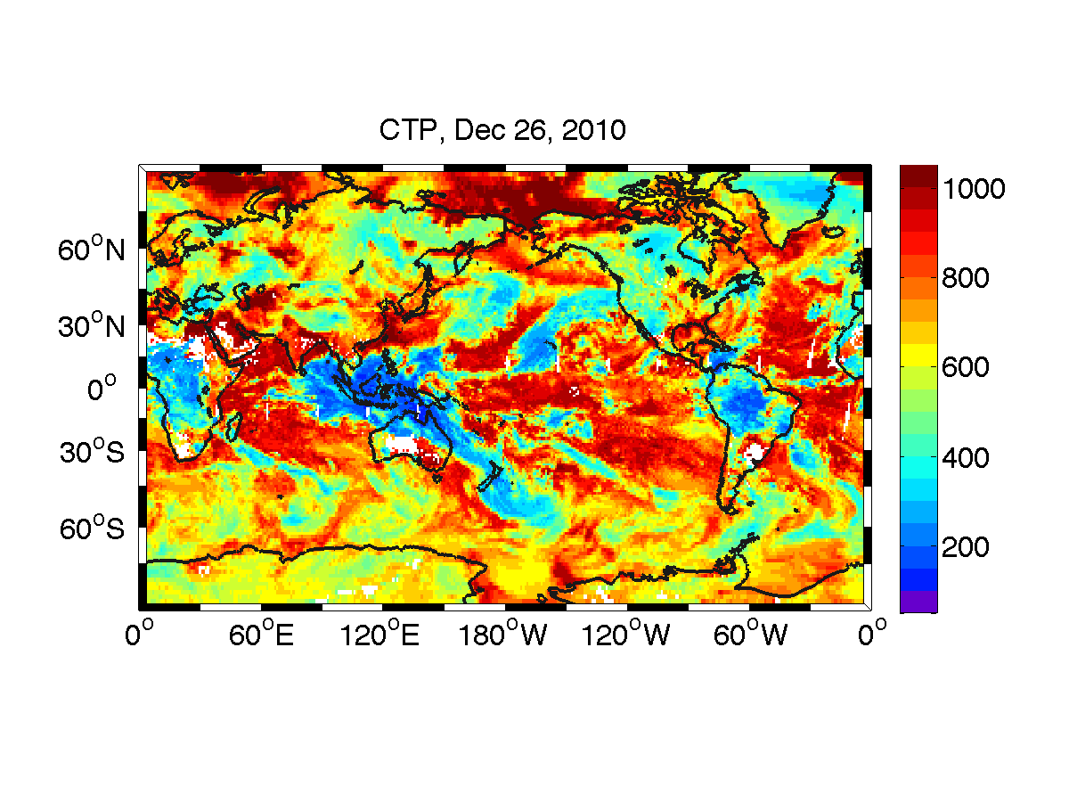
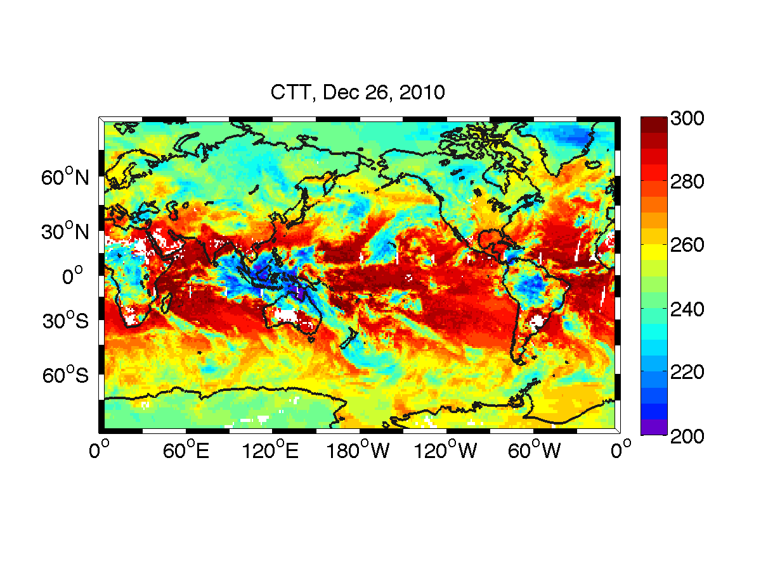
Next: I will make climatologies of CTP, CTT, cloudfraction

Slide 11
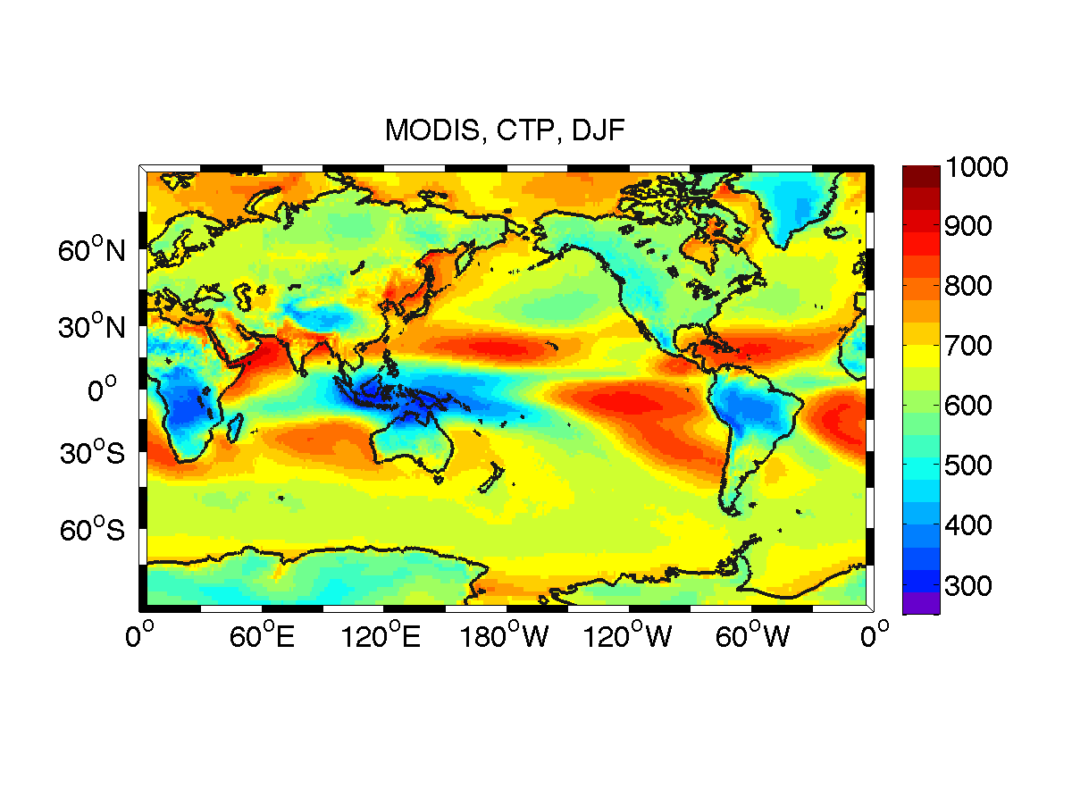
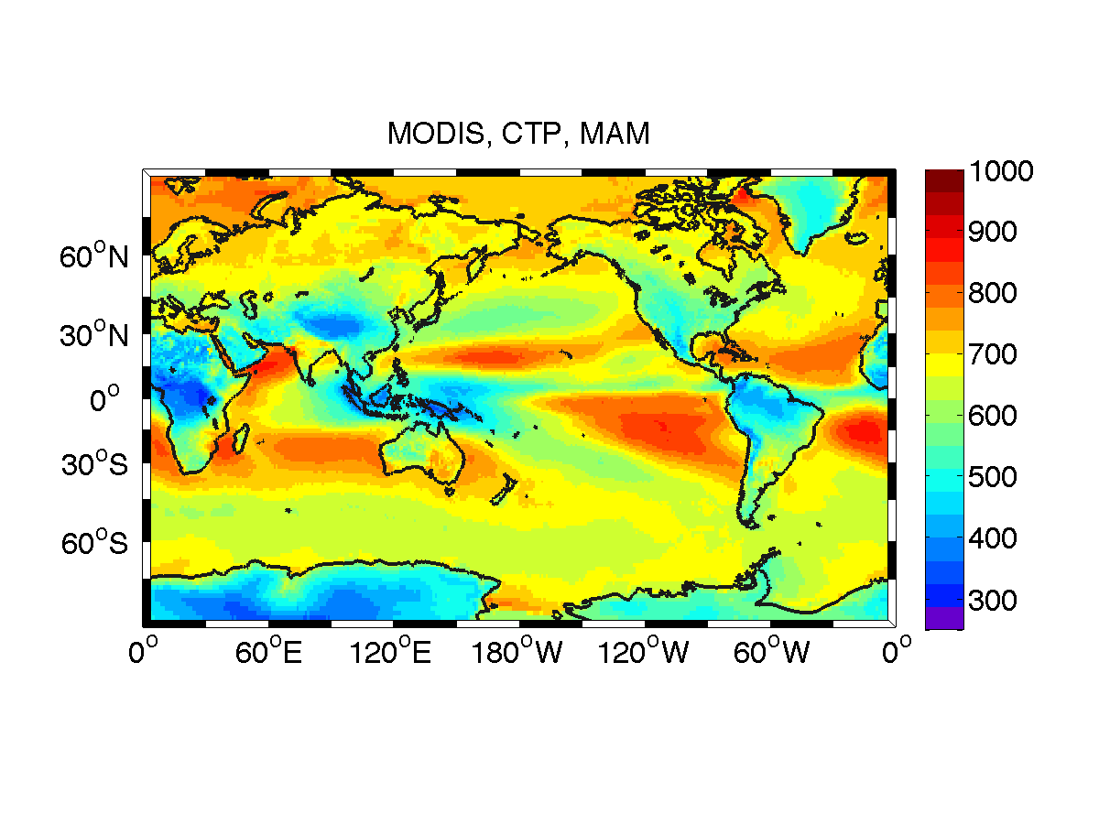
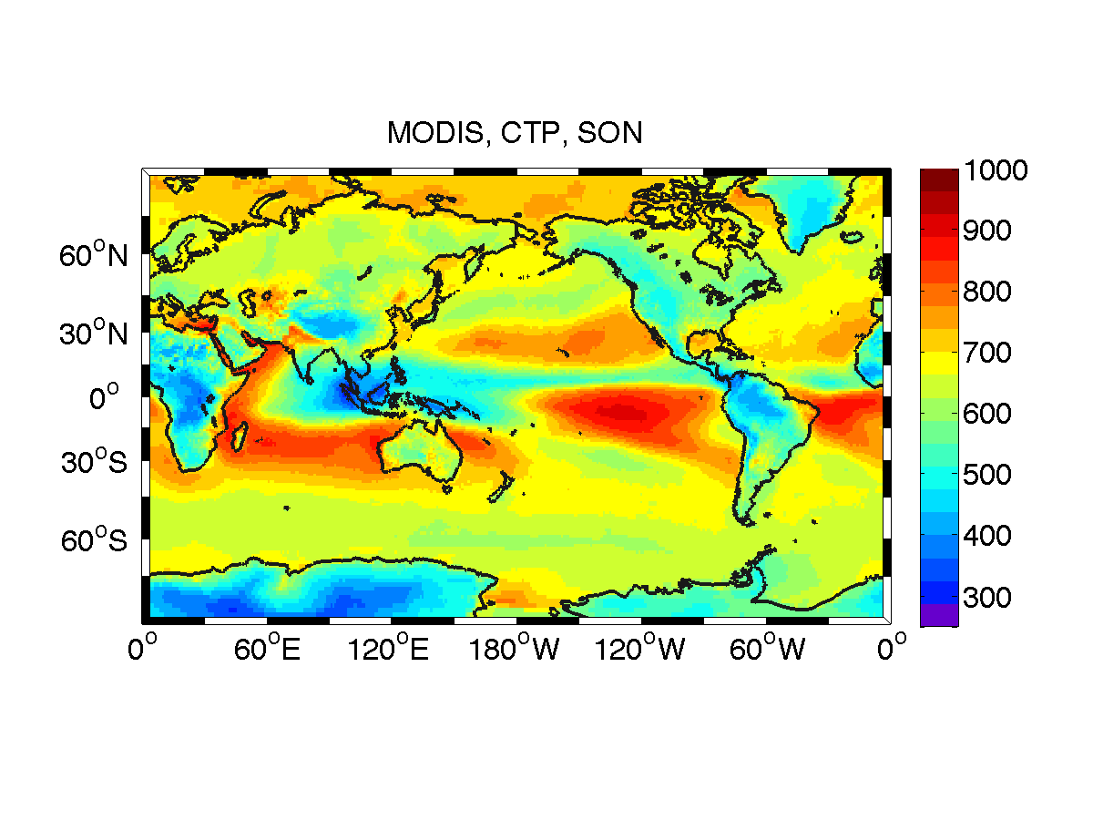
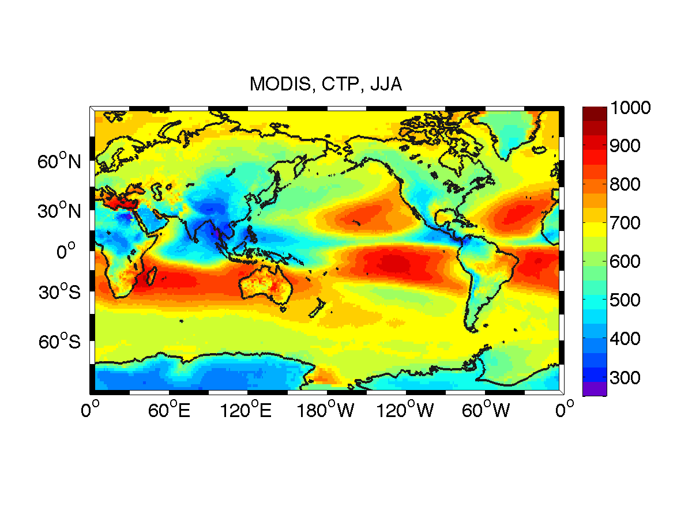
Annual Cycle
UNITS: hPa

Slide 12
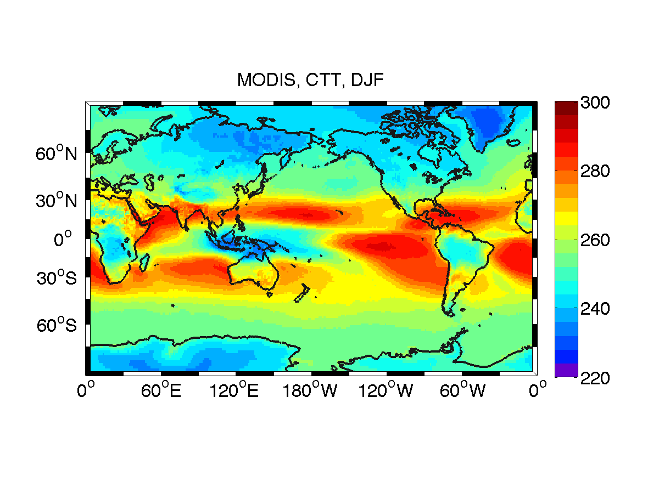
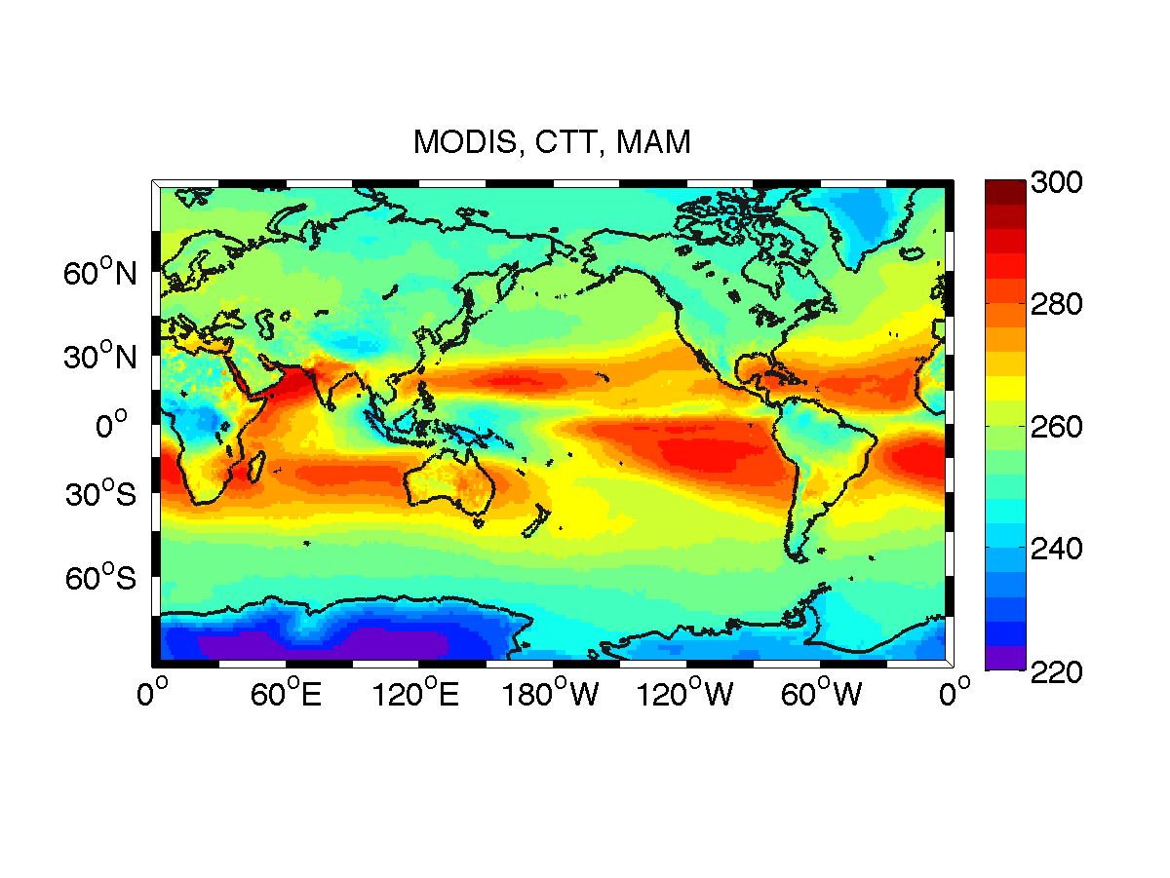
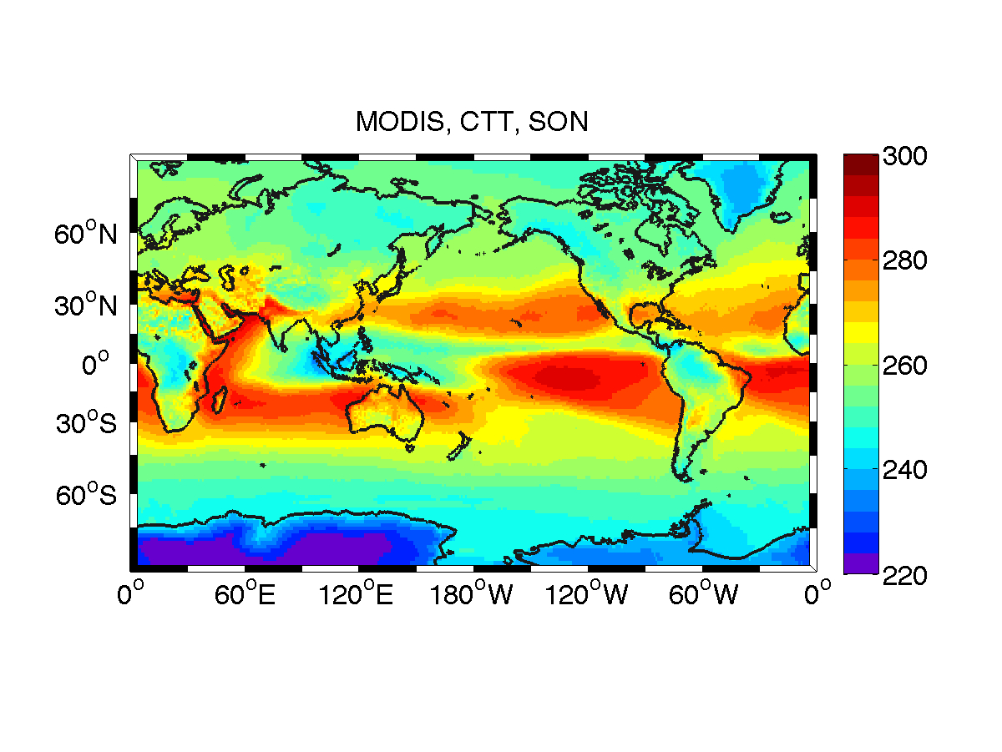
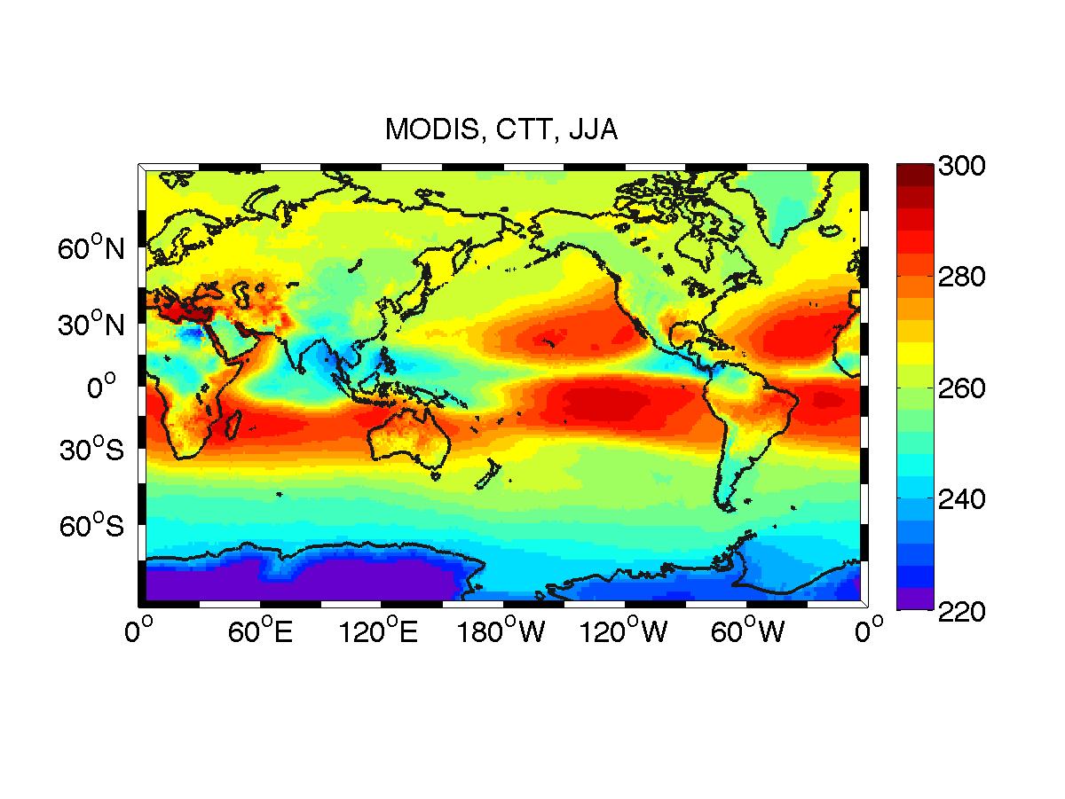
Annual Cycle
UNITS: K

Slide 13
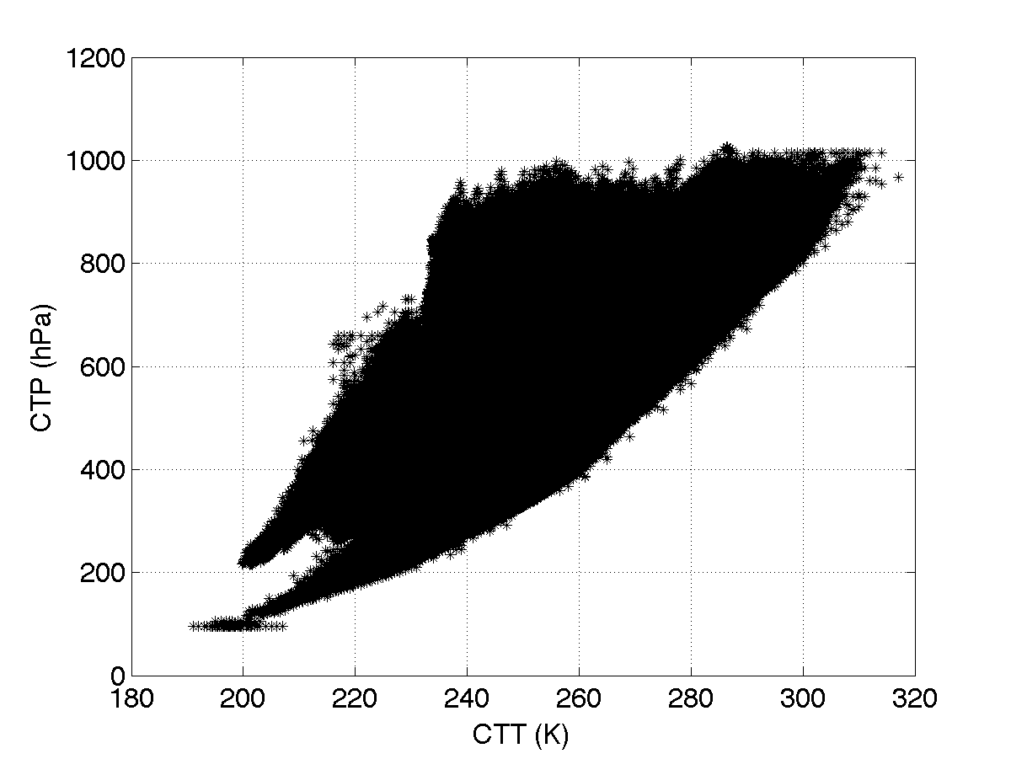
Scatter plot for all days (365), lat, and lon points in the climatology
Cloud Top Pressure
Cloud Top Temperature

Slide 14
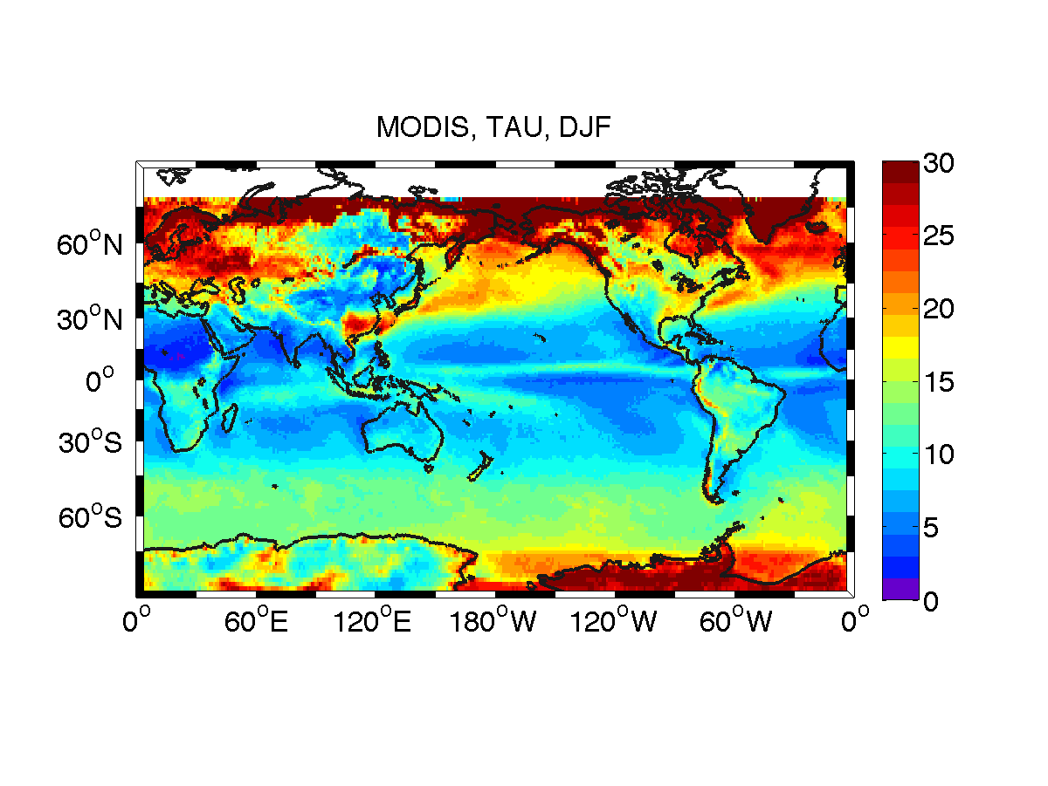
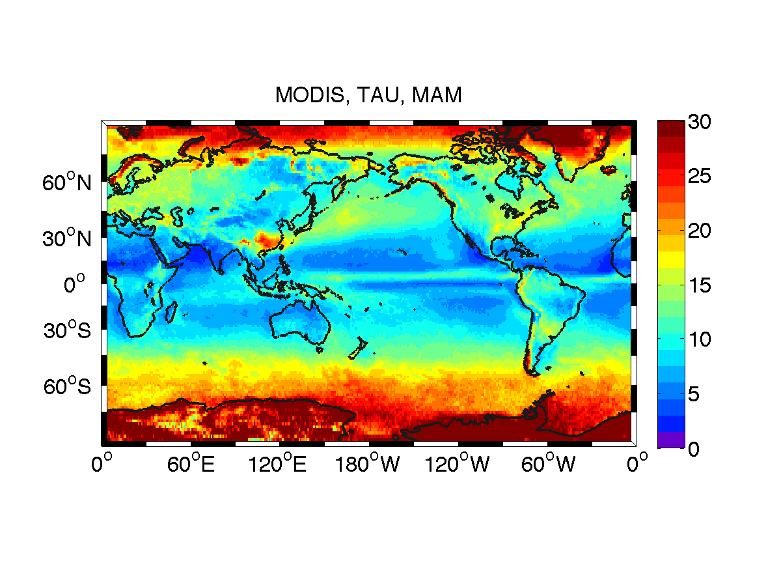
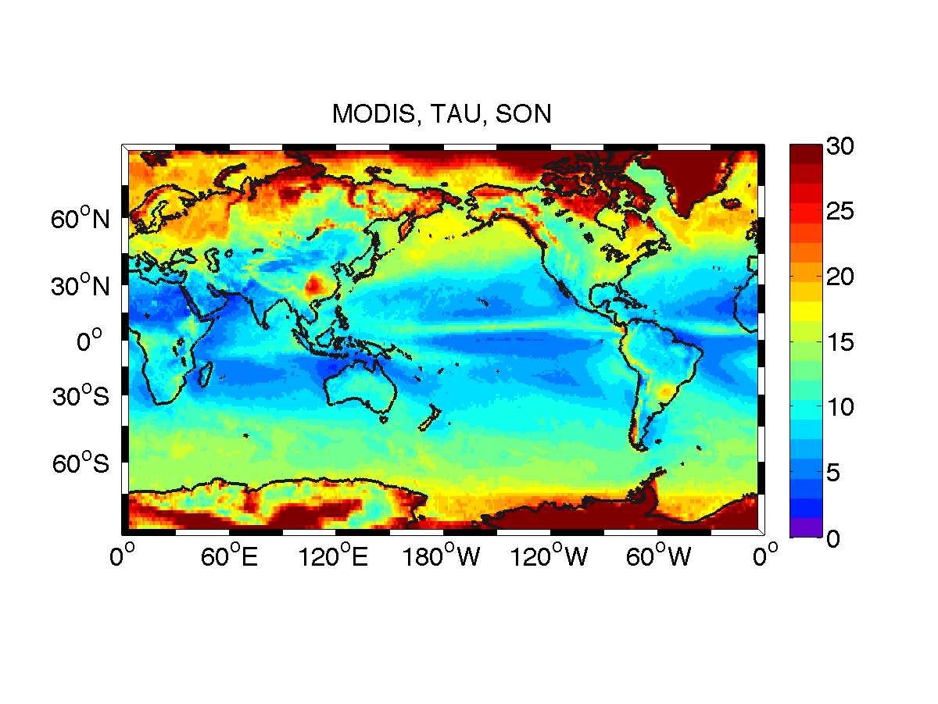
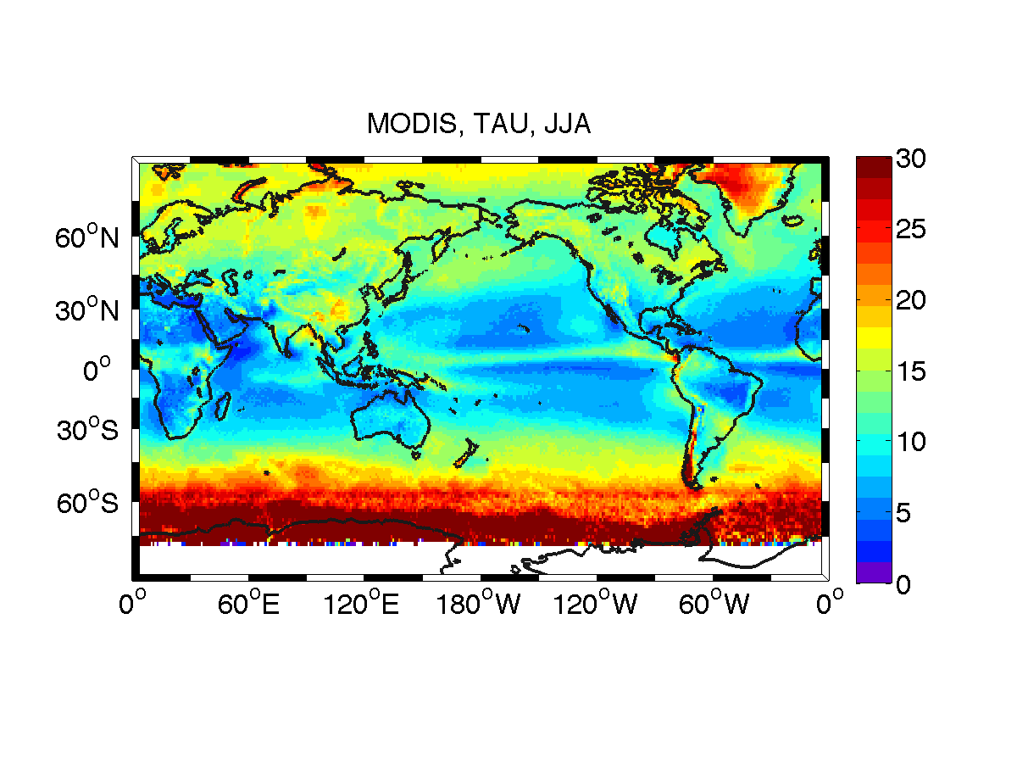
Annual Cycle
UNITS: unitless

Slide 15
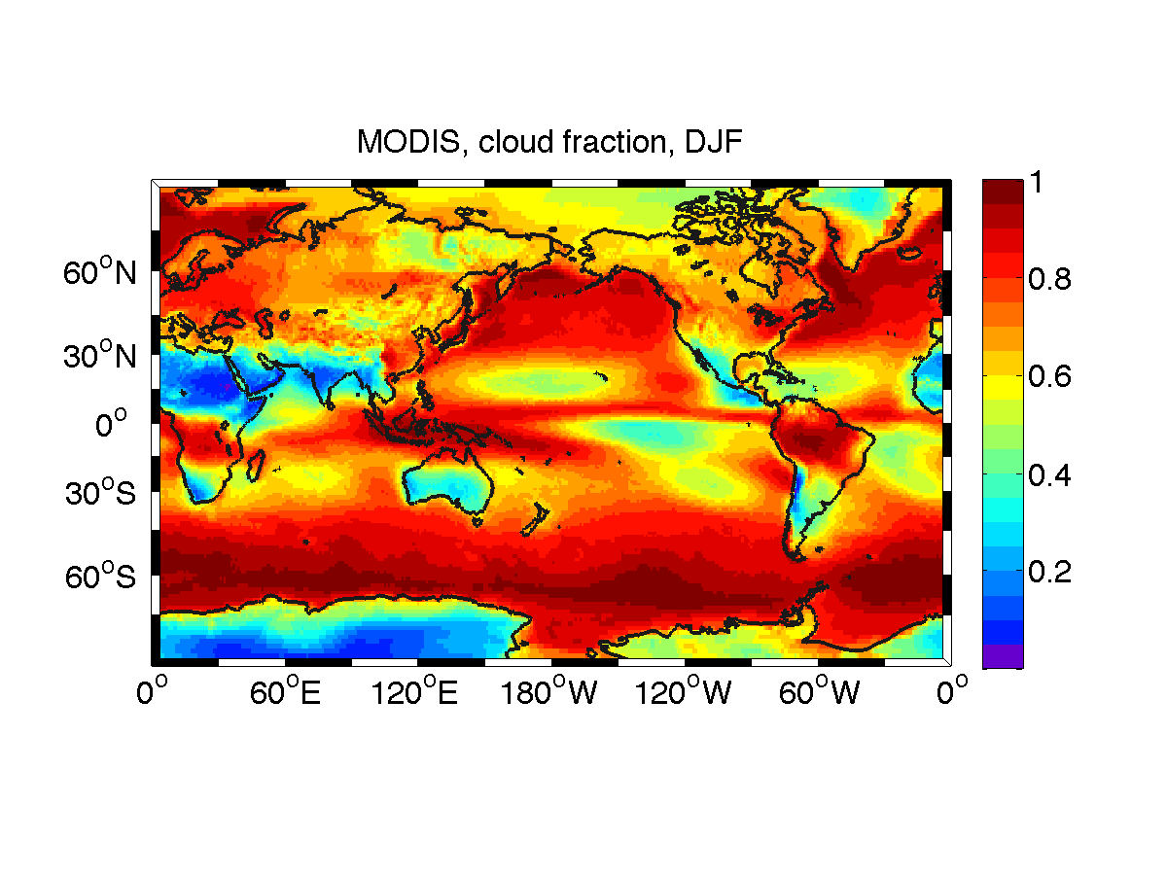
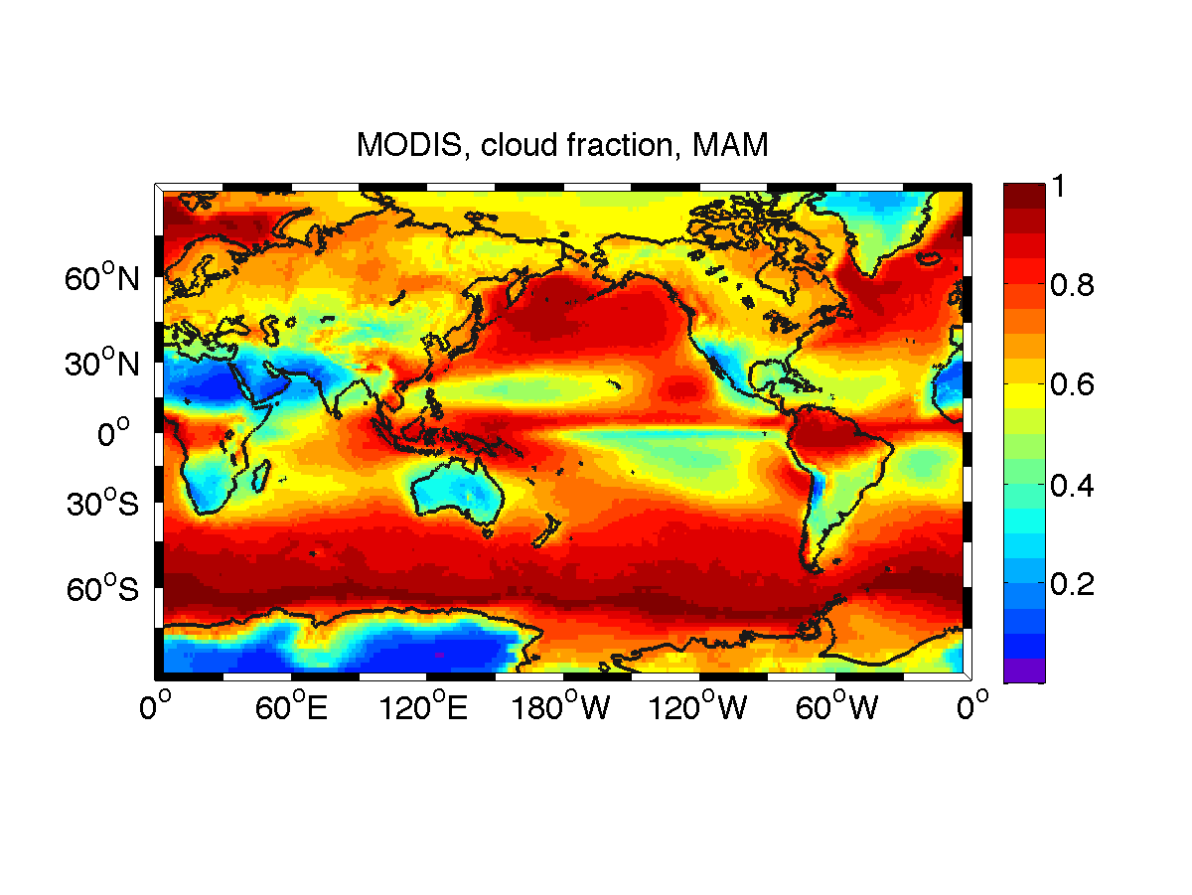
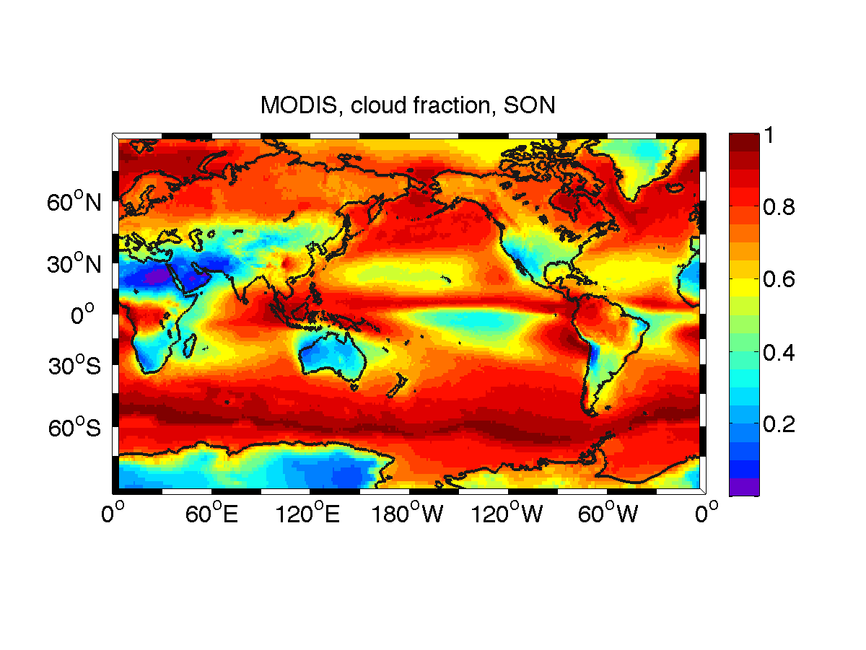
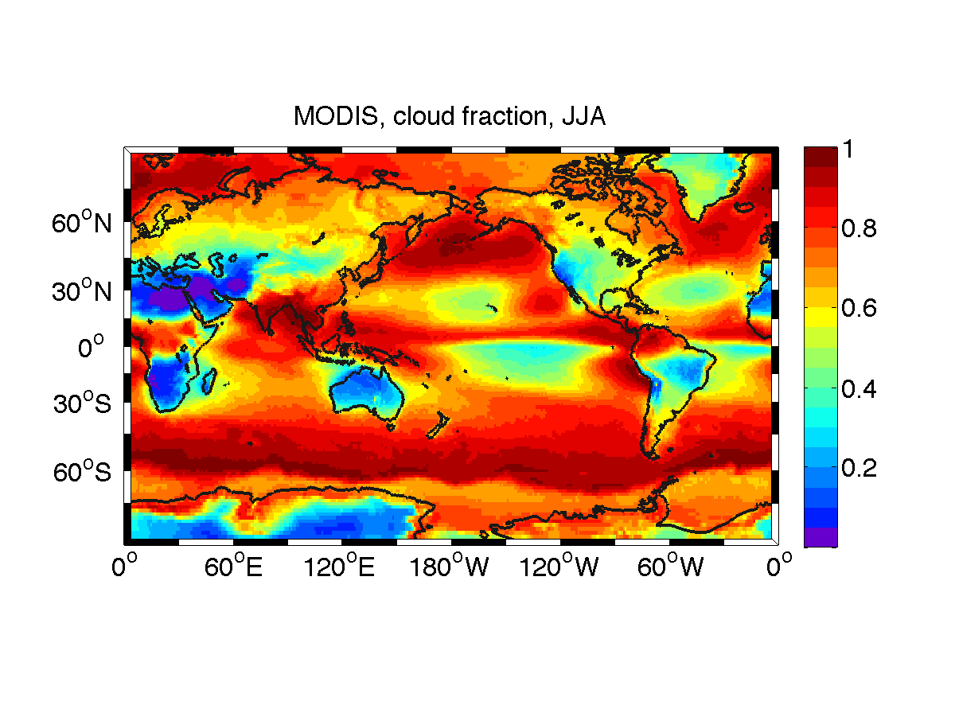
Annual Cycle
UNITS: %

